Slide 1


Session no.18
Subject: Engineering Chemistry
Course Code: ETCH104
Program: B.Tech. CSE (Full Stack/IBM/DS) SEM-I
Faculty Name: Dr. Divyanshi Mangla
(Assistant Professor)
School of Basic and Applied Sciences

Slide 2

Table of Contents
Pre-requisite
Characteristics of Batteries
Quiz
Support Material

Slide 3
Pre-requisite
Basic knowledge of Class 12th Chemistry
Electrode potential
Redox reactions
Batteries and its types

Slide 4
Course Outcomes
CO1 | Understand the methods for water hardness and the basics of boiler water treatment and analyze fuel calorific values and battery. | BTL2
CO2 | Explain the characteristics and working principles of different battery types and types of fuels. | BTL2
CO3 | Determine the differences between batteries and fuel cells and classify fuel cell types based on their components. | BTL4
CO4 | Identify between hard and soft water, solve the related numerical problems on water purification and emf and its significance in industry and daily life. | BTL3

Slide 5
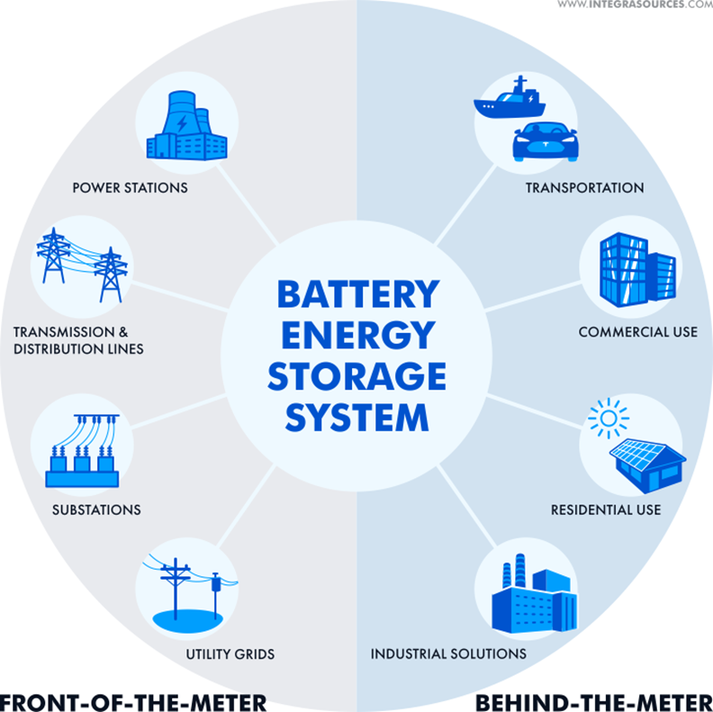
Importance of batteries
Battery Type | Applications
Primary | Portable devices, toys, flashlights
Secondary | Electric vehicles, renewable energy storage, backup power supplies
Reserve | Medical devices, military applications, emergency equipment
Fig 3 : Application of batteries
Notes:
New Courses replaced with New Programmes

Slide 6
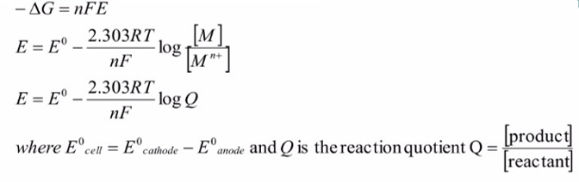
CHARACTERISTICS OF A BATTERY
VOLTAGE: The battery's voltage primarily relies on the properties of the individual cells that make up the battery system. The electromotive force (emf) of each cell is determined by the thermodynamic changes in the overall chemical reaction occurring within the cell, as described by the Nernst equation.
Note: Higher the standard electrode potential difference between the cathode and anode, the higher the emf of the cell and the voltage available from the battery.

Slide 7
CHARACTERISTICS OF A BATTERY
Current:
The higher the rate of spontaneous reaction, the higher the current.
The higher the surface area of the electrodes, the higher is the rate of reaction.
Current is measured in Ampere (A).
Electricity storage density:
It is the amount of electricity stored in the battery per unit weight of the battery.
Battery per unit weight of the battery i.e. it is the capacity per unit weight.
lt can be expressed in Coulombs/kg or in Ah/kg. The weight includes the weight of all components of the battery (i.e.. total weight of active material, electrolyte, terminals etc.)

Slide 8
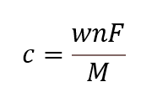
CHARACTERISTICS OF A BATTERY
Capacity: Capacity is a measure of the amount of electricity that may be obtained from the battery. It is expressed in Ah (ampere-hours). It is proportional to the amount of charge in Coulombs that may be transported from anode to cathode through the external circuit.
The charge (C) in Coulombs is given by the Faraday's relation:
Where C is the Capacity of the battery (in Ah)
W is Weight of the active material
n is number of electrons involved in discharge reaction
F is Faradays constant, 96500 C/mol
M is Molar mass. Current is a measure of the rate at which the battery is discharging.
Note: Higher the standard electrode potential difference between the cathode and anode, the higher the emf of the cell and the voltage available from the battery.

Slide 9

CHARACTERISTICS OF A BATTERY
Cycle Life :
Primary batteries are designed for single discharge and secondary batteries can be chargeable again and again. The number of charge and discharge cycles that are possible in secondary batteries, before failure occurs is called cycle life.
The cycle life of batteries must be high for secondary batteries.
Shelf Life:
The duration of storage under specified conditions at the end of which a cell or a battery retains its ability to work or to produce energy is called shelf life. A good battery should have more shelf life.
Energy efficiency:
The energy efficiency of a rechargeable battery is given by
It holds good only for the secondary battery.

Slide 10
Quiz
What is the primary function of a battery?
A) Energy generation
B) Energy storage
C) Energy conversion
D) Energy transmission Answer: B
Which parameter measures the total amount of charge a battery can store?
A) Voltage
B) Capacity
C) Power density
D) Energy efficiency Answer: B
What is the term used to describe the number of times a battery can be charged and discharged before its performance degrades significantly?
A) Shelf life
B) Cycle life
C) Energy density
D) Power density Answer: B
Which factor primarily determines the voltage output of a battery?
A) Electrode material
B) Electrolyte concentration
C) Temperature
D) Charge level Answer: A
Notes:
New Courses replaced with New Programmes

Slide 11

Practice Yourself
🔹 Q1. MCQ
Which of the following is not a desirable characteristic of a good battery? a) High energy density b) Low internal resistance c) Easily reversible reaction d) High toxicity
✅ Correct Answer: d) High toxicity
🔹 Q2. MCQ
Which of the following batteries is known for having a high energy-to-weight ratio and is commonly used in smartphones and laptops? a) Lead-acid battery b) Lithium-ion battery c) Nickel-Cadmium battery d) Mercury battery
✅ Correct Answer: b) Lithium-ion battery
🔹 Q3. Short Answer
Mention any two applications where batteries are essential.
✅ Answer:
Mobile phones
Electric vehicles (Other examples: calculators, emergency lights, medical implants, etc.)
🔹 Q4. Short Answer
List any three important characteristics that a battery must possess to be used in commercial applications.
✅ Answer:
High energy density
Rechargeability
Long cycle life
🔹 Q5. MCQ
Which of the following affects the performance of a battery? a) Electrode material b) Temperature c) Electrolyte composition d) All of the above
✅ Correct Answer: d) All of the above

Slide 12
📚 Key Takeaways:
Batteries are essential for powering portable electronics, vehicles, medical devices, and emergency systems.
A good battery should have:
High energy density
Low self-discharge
Reversibility (for secondary cells)
Safety, portability, and low maintenance
Battery performance depends on:
Electrode materials (e.g., Li, Pb, Zn, Cd)
Electrolyte type (liquid, gel, solid-state)
Operating temperature and charge/discharge cycles
Commercial viability of a battery also depends on cost, environmental impact, and recyclability.
Lithium-ion batteries are preferred in modern applications due to high efficiency and light weight.
Environmental and safety concerns must be addressed in battery design and disposal.

Slide 13
📚 Textbook References
Author(s) | Book Title | Publisher | Relevant Sections
P.W. Atkins & Julio de Paula | Physical Chemistry | Oxford University Press | Chapter 19 – Electrochemistry (pp. 670–692)
Bahl & Tuli | Essentials of Physical Chemistry | S. Chand Publishing | Chapter 9 – Batteries and Fuel Cells (pp. 670–690)
K.L. Kapoor | Electrochemistry & Solutions (Vol. 3) | Macmillan India | Chapter 5 – Batteries (pp. 120–140)
Sharma & Kaur | Physical Chemistry | Krishna Prakashan | Chapter on Batteries
Gurdeep Raj | Advanced Physical Chemistry | Goel Publishing House | Section: Batteries and Storage Cells

